Slide 2
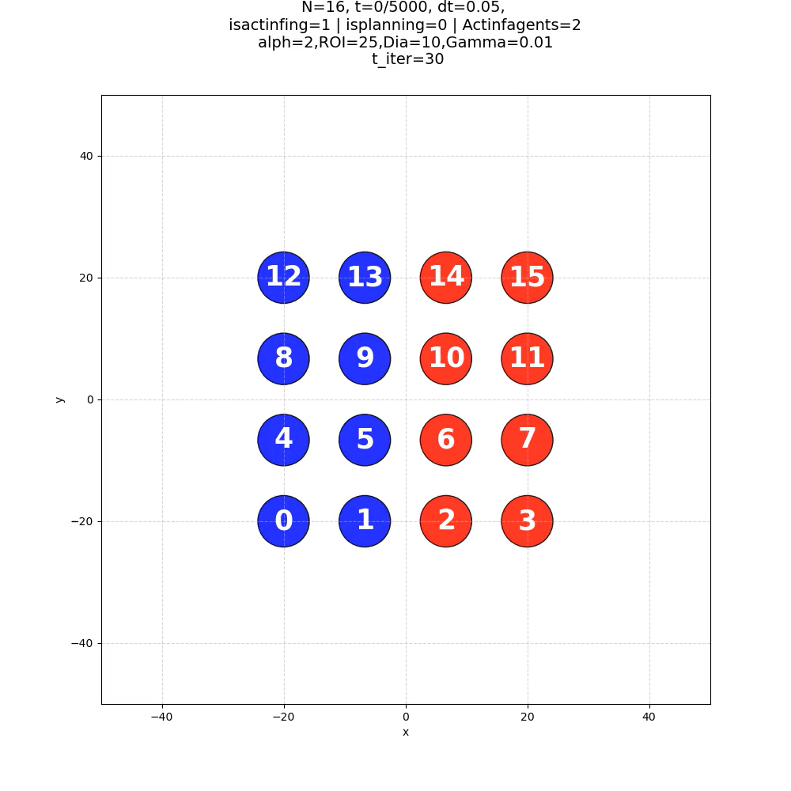
Agents starting from symmetric configuration, no planning, single step active, ignore 2 in heading

